Slide 1

SUSE at Home
Games

Slide 2


Project home
#proj-suse-at-home
https://github.com/SUSE/suse-at-home

Slide 3





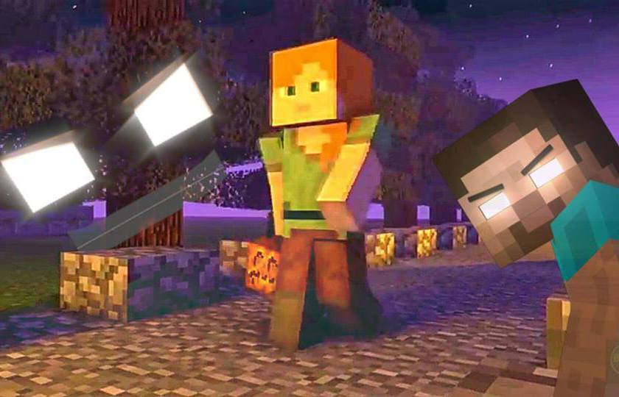
Today’s Goal
Minecraft
NFS Server
@Home Base
/k8s-data/mc-data

Slide 4
Agenda
Tools
Minecraft Clients
Install Minecraft
Apply Worlds

Slide 5

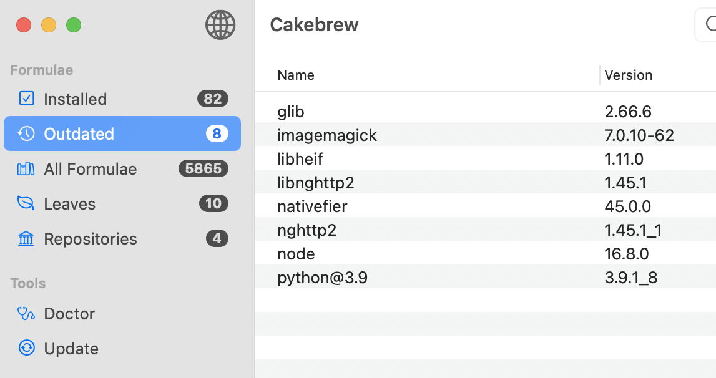
Cakebrew
Visual status of Brew installed Applications
Search, install, upgrade and remove

Slide 6



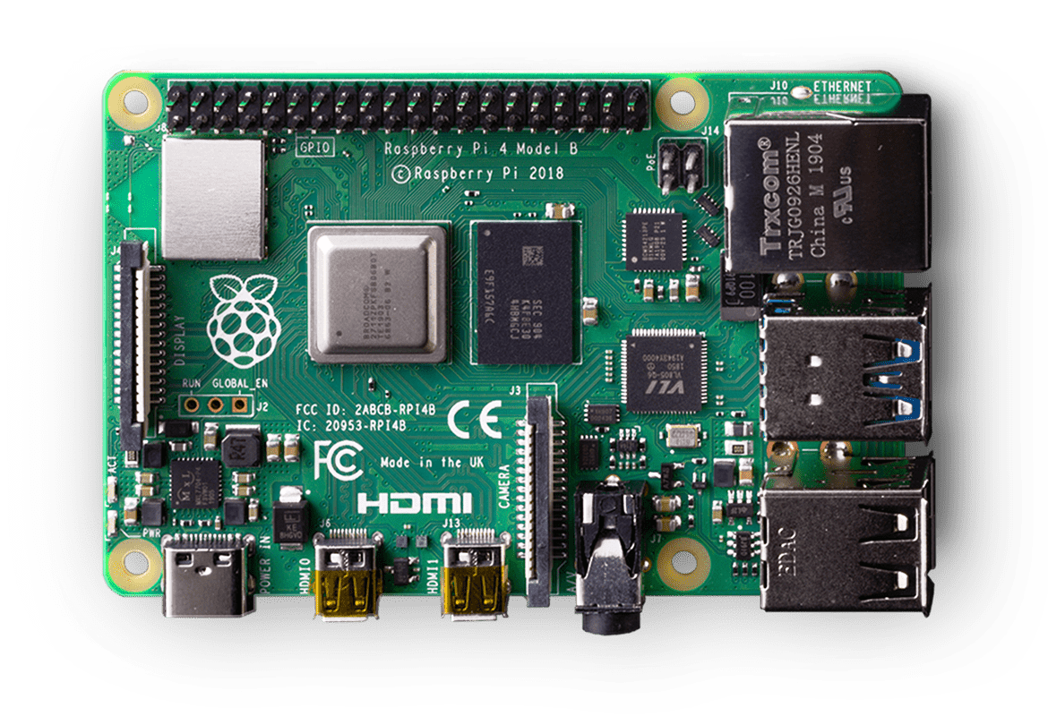

SUSE at Home Base
Storage Class
NFS-Provisioner
LocalPath
SLE 15 sp3 or Leap

Slide 7

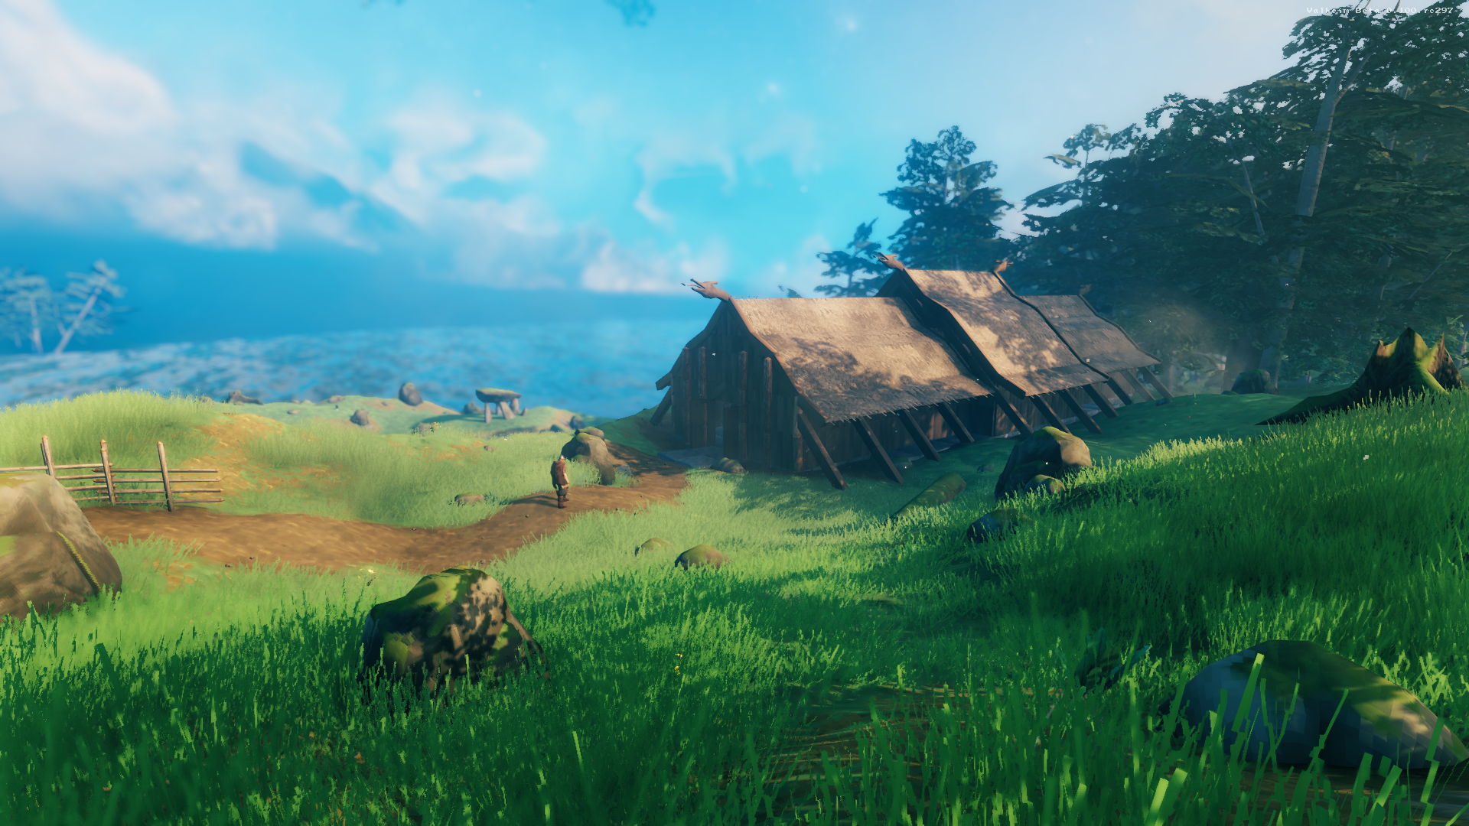
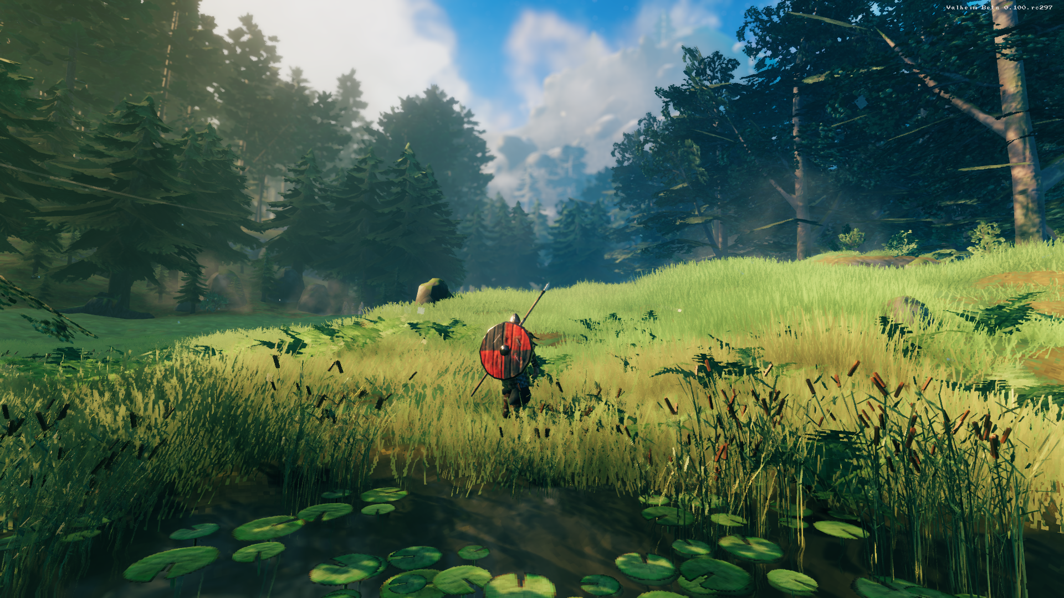
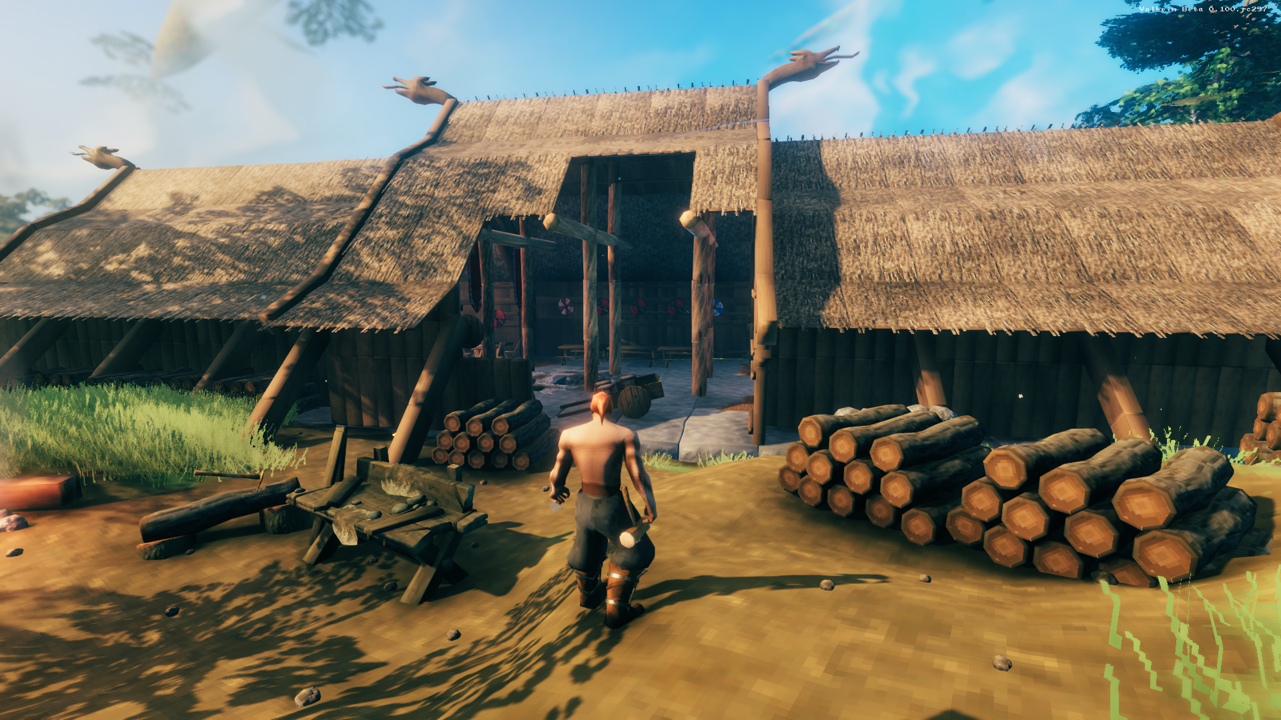
A brutal exploration and survival game for 1-10 players, set in a procedurally-generated purgatory inspired by viking culture. Battle, build, and conquer your way to a saga worthy of Odin’s patronage!
7

Slide 8
valheim
Add Helm Repo
https://github.com/Addyvan/valheim-k8s
2x

Slide 9
WHAT TO LISTEN TO WHEN INSTALLING… They Call Me Steve – Teenage Bottlerocket

Slide 10
Clients - https://wiki.vg/Client_List

Slide 11

Java Edition
Original
Supports Java Clients (Win,Mac,Linux)
3rd Party + Opensource Clients
Very customizable when creating Worlds
Lots of Mods, Skins and Worlds
Bedrock Edition
Created by Microsoft in 2017
Fast
*new features first
Supports Consoles
Very linted customizable when creating Worlds
Some Mods, Skins and Worlds but growing

Slide 12
Minecraft Server links
All the geeky data about the Server and how it is running
https://github.com/itzg/docker-minecraft-server

Slide 13
https://www.planetminecraft.com

Slide 14
world data
Downloadable world
Instead of mounting the /data volume, you can instead specify the URL of a ZIP file containing an archived world. It will be searched for a file level.dat and the containing subdirectory moved to the directory named by $LEVEL. This means that most of the archived Minecraft worlds downloadable from the Internet will already be in the correct format.

Slide 15
Modpack
Modpack data directory
By default, CurseForge modpacks are expanded into the sub-directory /data/FeedTheBeast and executed from there. (The default location was chosen for legacy reasons, when Curse and FTB were maintained together.)
The directory can be changed by setting CF_BASE_DIR, such as -e CF_BASE_DIR=/data.

Slide 16
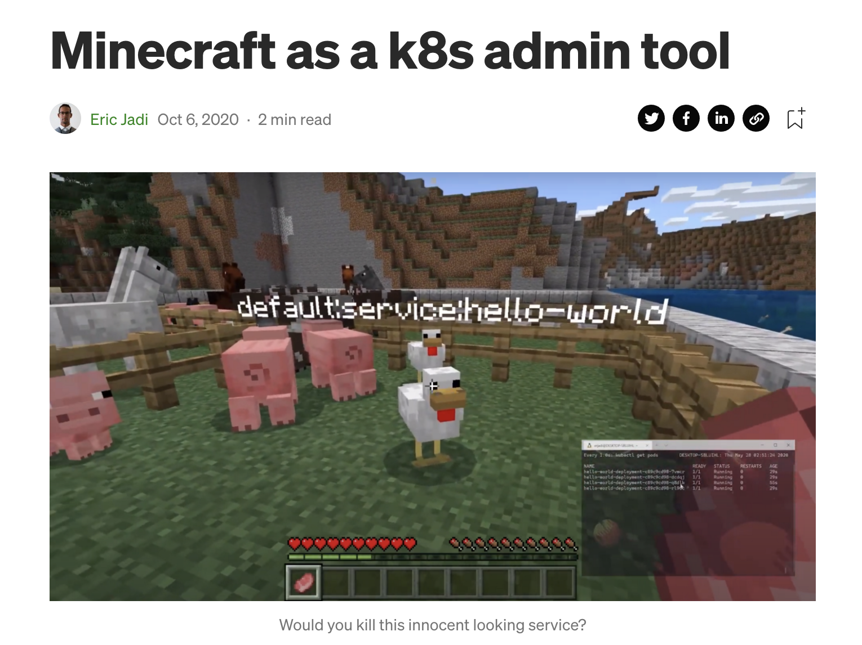
https://eric-jadi.medium.com/minecraft-as-a-k8s-admin-tool-cf16f890de42

